Slide 1

AIRBNB HOTEL BOOKING ANALYSIS
K Ranga Nitheesh Kumar Reddy APPLY_175569249068a5bdca6dbf5

Slide 2

PROBLEM STATEMENT
Airbnb allows property owners to rent homes or apartments to travelers. A key challenge for hosts is setting the right price, which depends on factors like the number of bedrooms and bathrooms, cleanliness, listing accuracy, and communication quality with guests.

Slide 3
Project Description This project builds a machine learning regression model to predict Airbnb listing prices. By analyzing historical data and listing attributes—such as number of bedrooms, bathrooms, and guest ratings—the model helps hosts set optimal prices, maximizing occupancy and earnings, while ensuring fair and competitive rates for travelers.

Slide 4

WHO ARE THE END USERS?
Airbnb Hosts
Optimize listing prices based on property features and guest reviews.
Travelers
Assess whether a listing is fairly priced.
Airbnb Platform Analysts
Enhance automated pricing suggestions and platform trust.
Researchers/Students
Study how property features and reviews influence rental pricing.

Slide 5

Technology Used
Python: Core programming language
Pandas & NumPy: Data cleaning and preprocessing
Scikit-learn: Machine learning, regression modeling, and evaluation
Matplotlib & Seaborn: Data visualization and feature analysis
Google Colab: Cloud-based environment for project execution
File Handling: openpyxl for Excel, built-in CSV handling

Slide 6
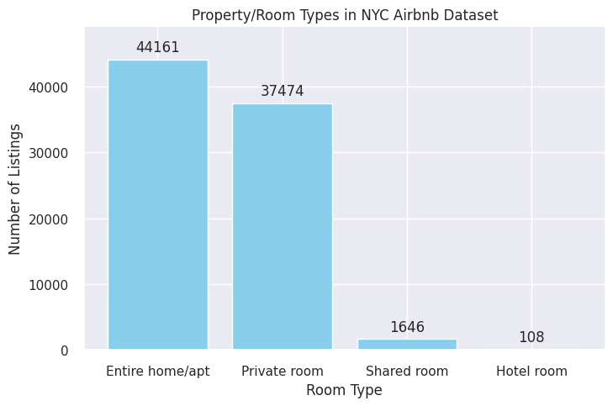
RESULTS1
The dataset contains five different neighborhood groups, namely Brooklyn, Manhattan, Queens, Bronx, and Staten Island. According to the barchart, Brooklyn has the highest number of listings with 34636, followed closely by Manhattan with 34566.

Slide 7
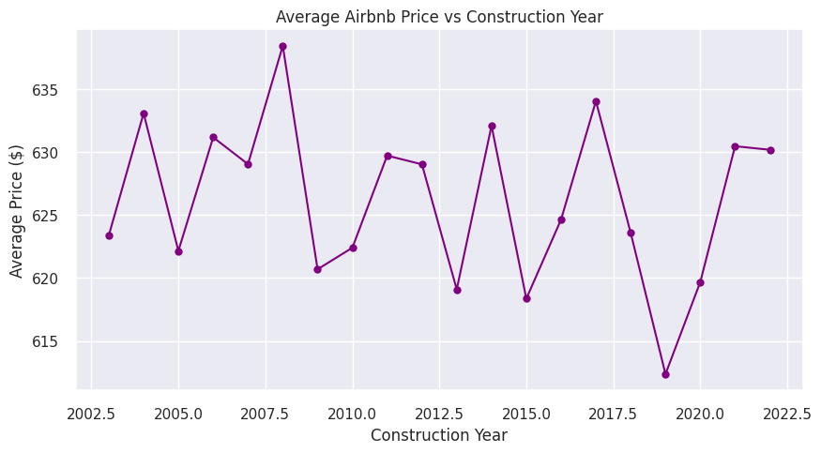
RESULTS2
The line plot depicting the construction year of properties versus the average price per property reveals a noticeable downward trend in prices as the construction years progress. The pattern demonstrates decreasing lows and highs. suggesting an overall decline in property prices as time progresses.

Slide 8
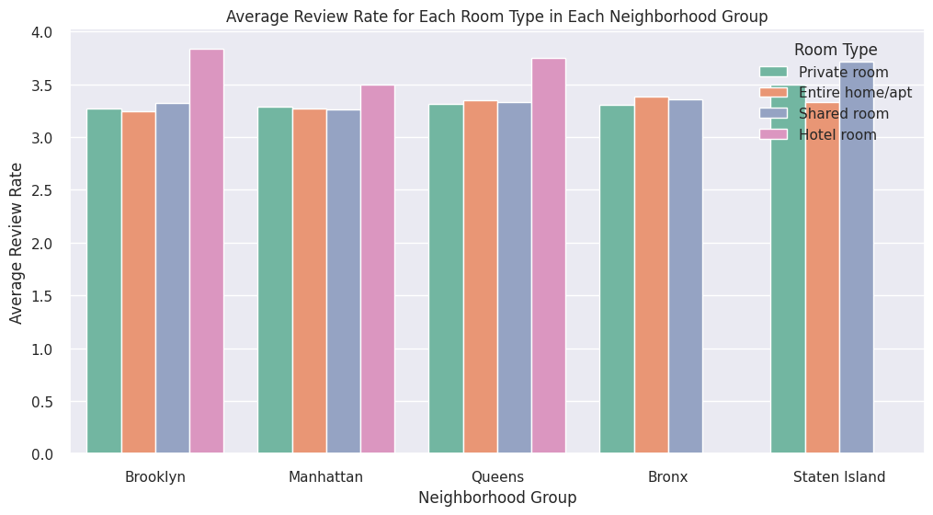
RESULTS3
Hotel rooms exhibit has higher review rate compared to all other property types within the three neighborhood groups where they are located: Brooklyn, Manhattan, and Queens.

Slide 9
GitHub repository
https://github.com/Krnkreddy/VOIS_AICTE_Oct2025_KRangaNitheeshKumarReddy.git

Slide 10

Getting started with Basics of Python Certificate

Slide 11

Data Visualization Certificate

Slide 12
Thank you
.
.

